Slide 1
Feature Engineering & EDA Assignment
Industry Case - Credit card Transaction Data
KNN - Clustering
Varadharajan Suresh
vs2769

Slide 2
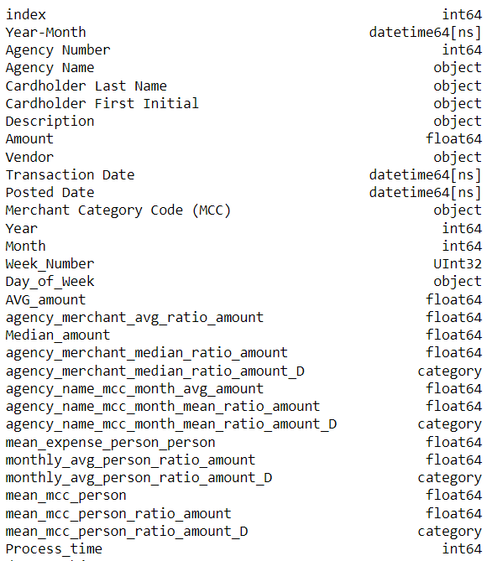
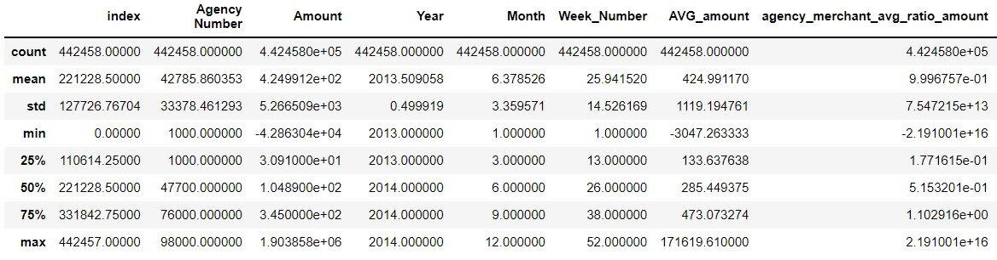
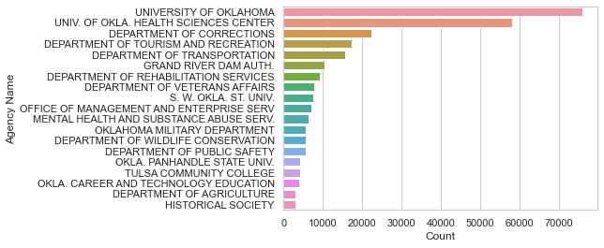
Introduction to Data

Slide 3
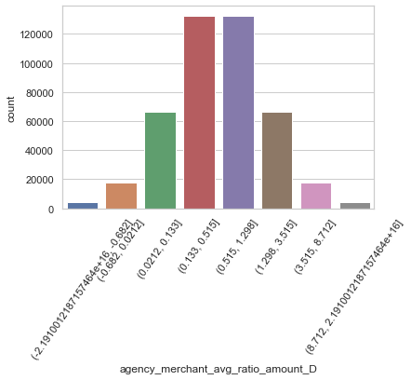
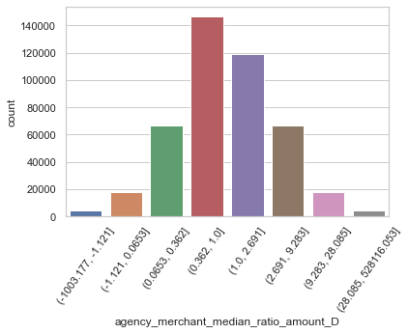
Feature engineering: Features 1 & 2
Grouping by agency, MCC we calculate the median amount spent. This helps understand the median expenditure for a person in an agency per merchant category.
Grouping by agency, MCC we calculate the average amount spent. This helps understand the mean expenditure for a person in an agency per merchant category.

Slide 4
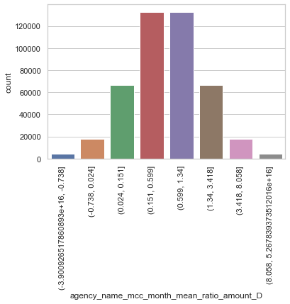

Feature engineering: Features 3 & 4
Grouping by agency, MCC and Month we calculate the average amount spent. This helps understand the monthly expenditure for a person in an agency per merchant category.
Grouping by Year, Month and Person we calculate the average amount spent. This helps understand the average monthly expenditure in year per person

Slide 5
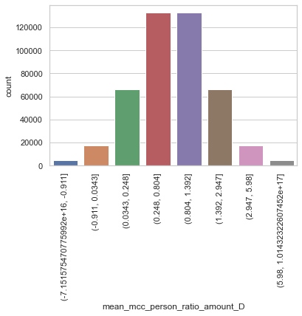
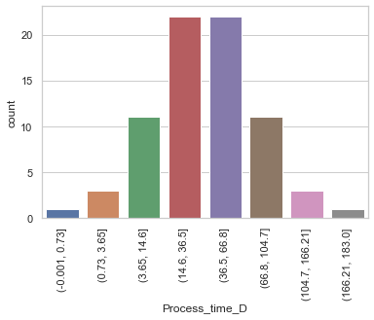
Feature engineering: Features 5 & 6
Posted Time – Transaction Time
Grouping by Cardholder Last Name and merchant category code and obtaining the average amount spent by a person in a merchant category.

Slide 6
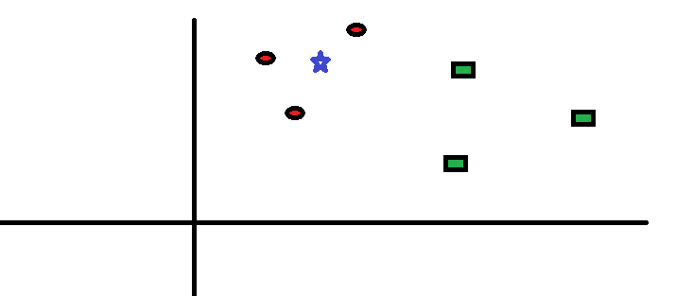
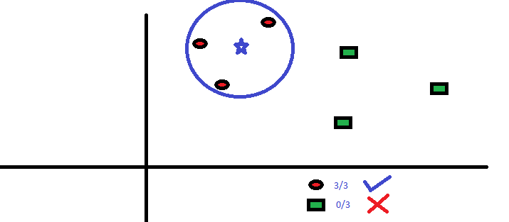
KNN Clustering
How it works?
Step 1: Determine the value for K
Step 2: Calculate the distances between the new input (test data) and all the training data. The most commonly used metrics for calculating distance are Euclidean, Manhattan and Minkowski
Step 3: Sort the distance and determine k nearest neighbors based on minimum distance values
Step 4: Analyze the category of those neighbors and assign the category for the test data based on majority vote
Step 5: Return the predicted class

Slide 7
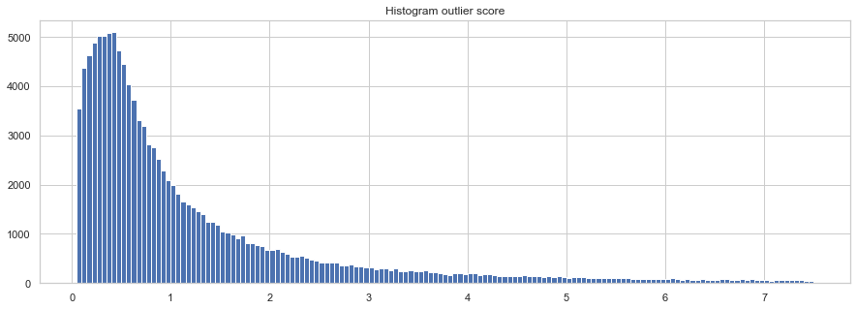
KNN Clustering
1.5

Slide 8
Challenges
Lack of Compute power
Memory resources

